Slide 1

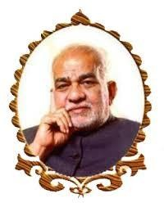
BVRIT HYDERABAD College of Engineering for Women
Department of Information Technology
VIDEO STREAMING CAPTION GENERATOR USING DEEP LEARNING
Under the Guidance of:
Name: Mr. A Rajashekar Reddy
Designation: Assistant Professor
Team No : 12
N. Prasanna Laxmi - 19WH1A1283
B. Navya - 19WH1A12A2
T. Srilatha - 20WH5A1207
CH. Madhuri - 20WH5A1208

Slide 2
AGENDA
Title
Summary of Stage 1
Implementation of Experimental Design
Execution video
Analysis of Results, Discussion
Conclusion and Future scope

Slide 3
SUMMARY OF STAGE - 1
This video streaming caption generator consists of two phases- training phase and prediction phase. Caption generation is performed using the Convolutional Neural Network Algorithm.
A video will be provided as input, and using the CNN algorithm features will be extracted, and the most accurate caption will be produced.
In Stage – 1, The model is being trained. Video is captured and they are considered as frames simultaneously. All modules must be integrated in order for the generation of captions for the given video stream to be effective.

Slide 4
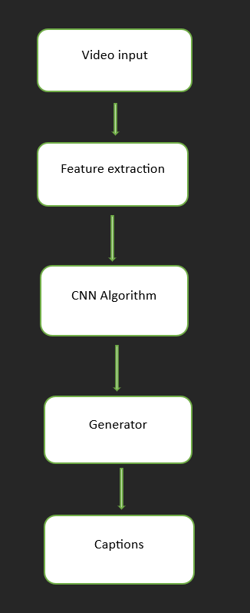
Implementation of Experimental Design
Figure : implementation design of video streaming caption generator

Slide 5
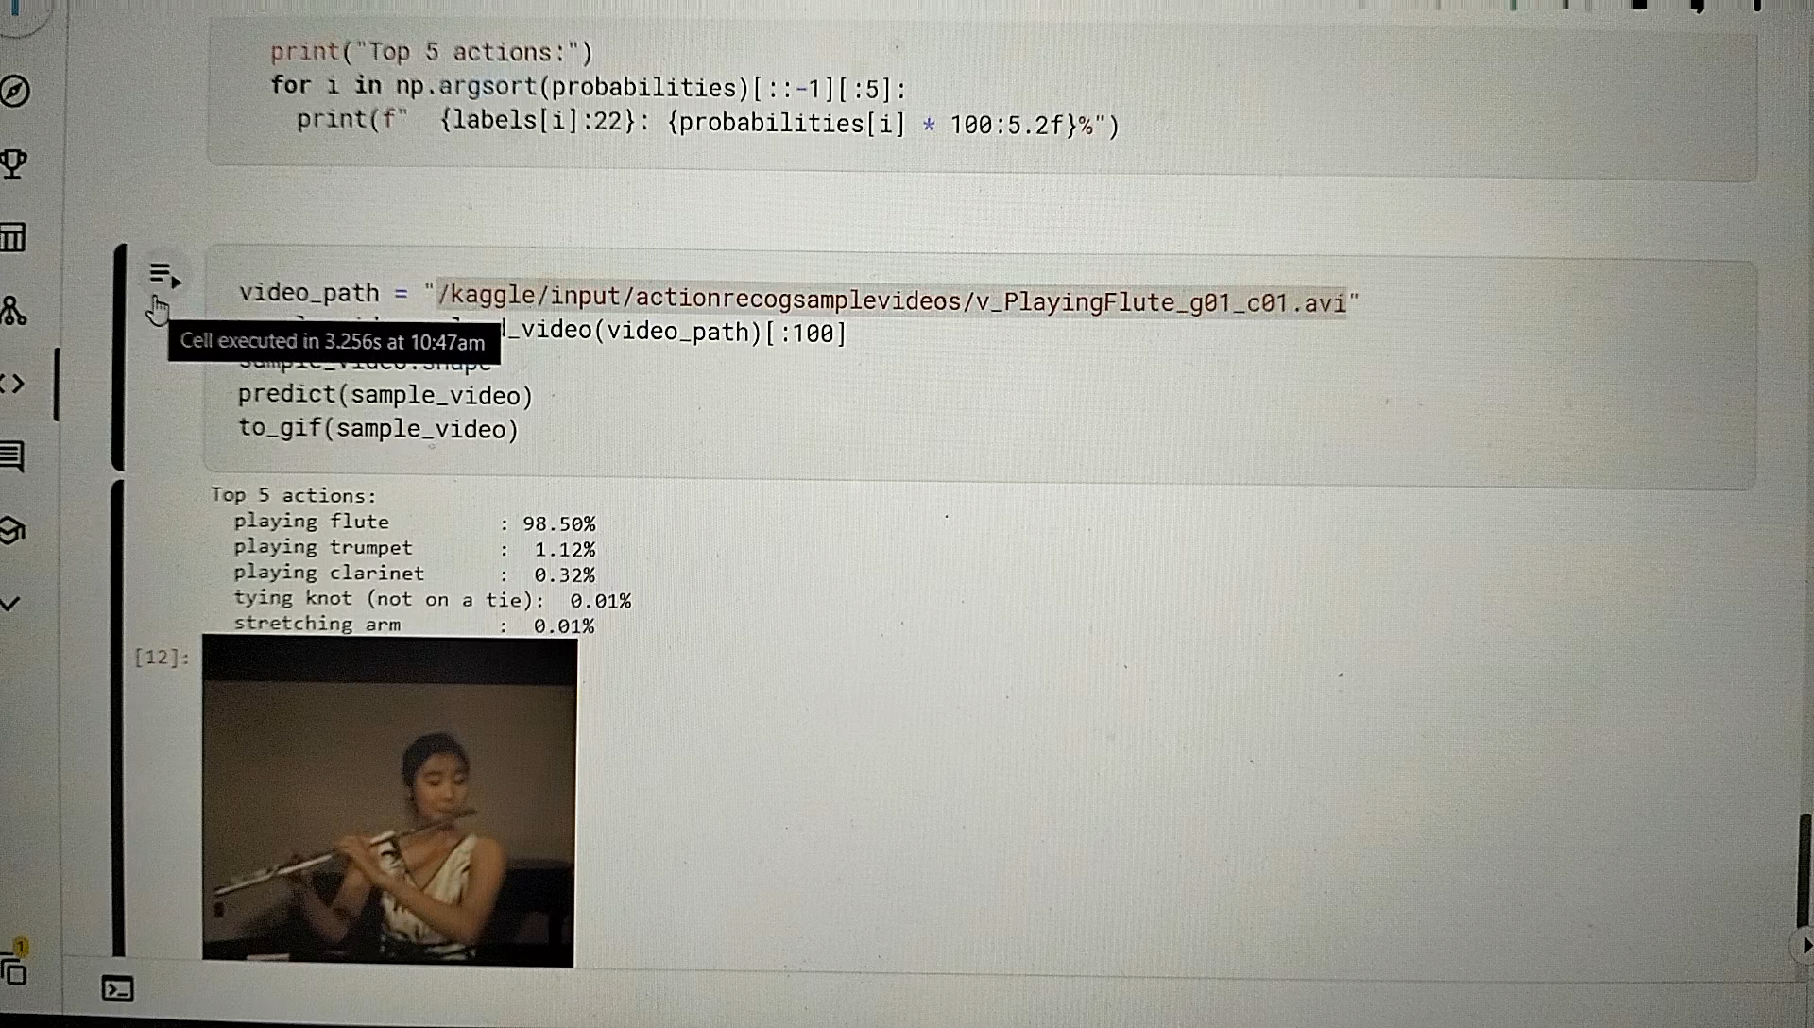
Execution video

Slide 6
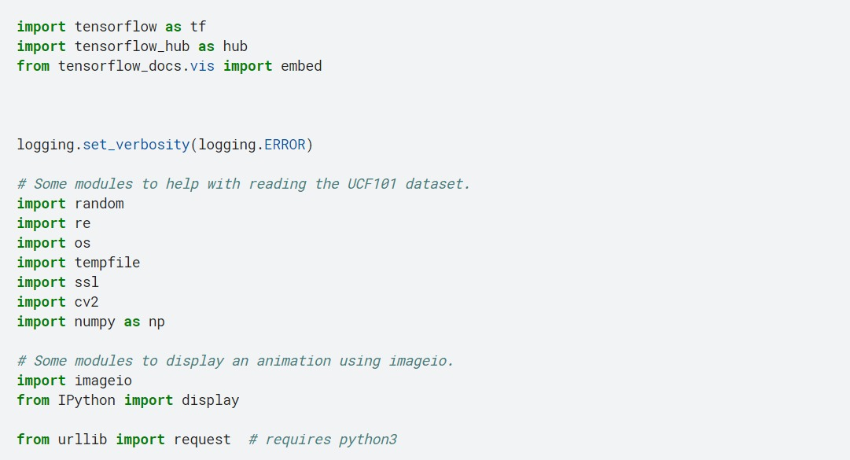
IMPLEMENTATION OF MODULES

Slide 7
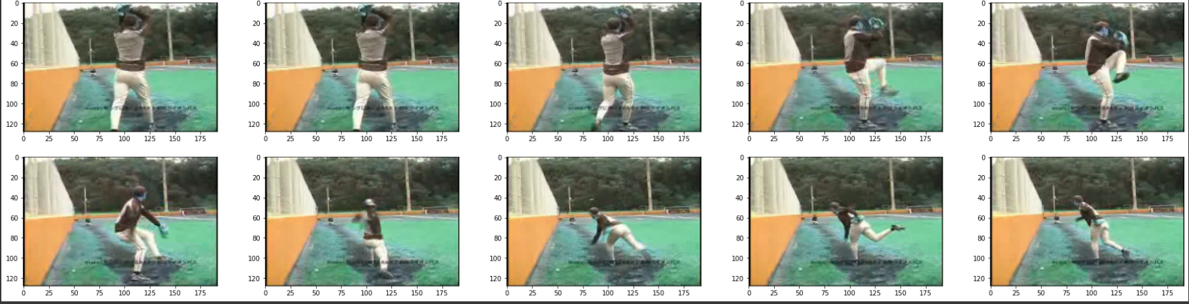
CAPTURE

Slide 8
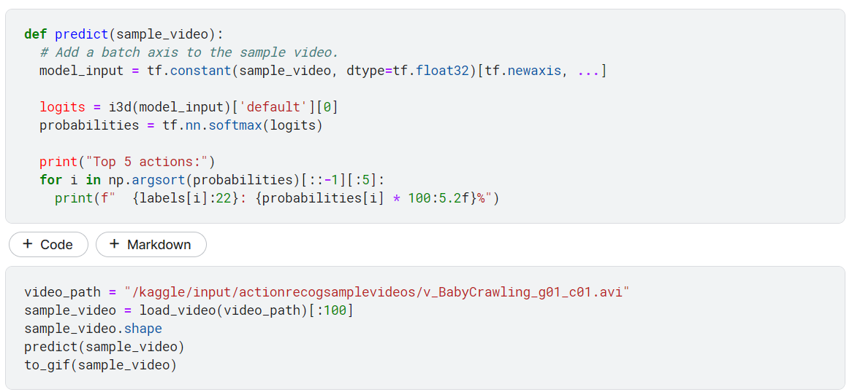
PREDICTION

Slide 9
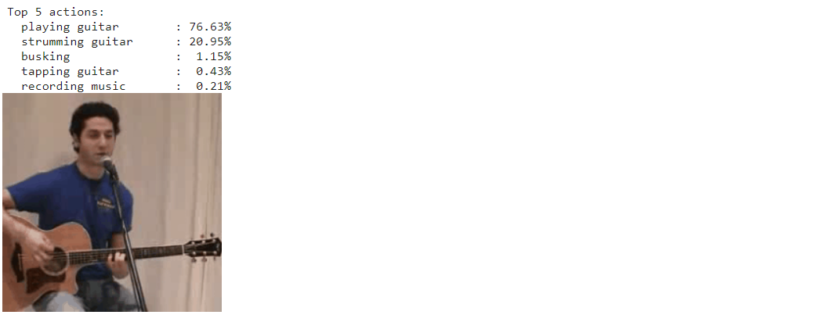
OUTPUT

Slide 10
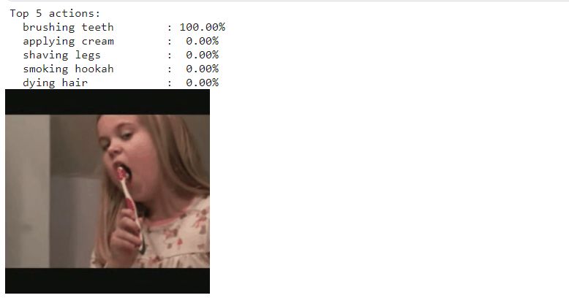
OUTPUT

Slide 11
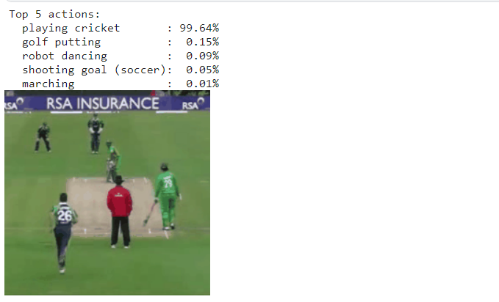
OUTPUT

Slide 12
CONCLUSION
We devise a effective video stream caption generator, When a video is provided as input, a caption will be produced for the given output using the convolutional neural network algorithm.
We are working on improving the accuracy and integrating all modules and publish the IEEE journal within a period of one month.

Slide 13
REFERENCES
Muhammad Rafiq, Ghazala Rafiq, Gyu Sang Choi, "Video Description: Datasets & Evaluation Metrics", IEEE Access, vol.9, pp.121665-121685, 2021.
Jyoti Madake, Shripad Bhatlawande, Swarali Purandare, Swati Shilaskar, Yash Nikhare, "Dense Video Captioning using BiLSTM Encoder", 2022 3rd International Conference for Emerging Technology (INCET), pp.1-6, 2022.
Vikash Raja Mallick, Dinesh Naik, "Attention based Image Captioning using Depth-wise Separable Convolution", 2021 12th International Conference on Computing Communication and Networking Technologies (ICCCNT), pp.1-6, 2021.
Li, T., Hua, M., Wu, X. (2020). A hybrid CNN-LSTM model for forecasting particulate matter (PM2. 5). IEEE Access, 8, 26933-26940.

Slide 14
THANK YOU

